Slide 1
Quick Start Grant Webinar Series: Enabling Faster Installations Part I
Presented by IHACI and Small Planet Supply
July 24, 2023

Slide 2
TECH Clean California & the Quick Start Grant Program
California’s goal: 6 million heat pumps installed by 2030
Climate change-ready / friendly homes (3 million by 2030)
50% of funding delivered to low-income households or disadvantaged communities
TECH Clean California Strategy
Encourage deployment innovation
Rapidly refine specific needs
Test innovative program delivery models that address key market barriers and increase access to electrification
Provide the funding source innovative approaches need to scale
QUICK START GRANT PROGRAM

Slide 3
Agenda
1 | Visual Service Software Bob Wiseman, IHACI
2 | Central Heat Pump Boiler Innovation with Water Droplet Albert Rooks, Small Planet Supply
3 | Q&A and Panel Discussion Peter Florin, Energy Solutions Jed Hannemann, Energy Solutions Chris Badger, VEIC Bob Wiseman, IHACI Albert Rooks, Small Planet Supply

Slide 4
Grantee Presentations
2

Slide 5
Participation Logistics
You are automatically muted by Zoom upon entering the webinar
Please submit questions through the Q&A function (please indicate whom your question should be directed to)
Fill out the post-webinar survey with your contact information if you’d like to get involved!

Slide 6
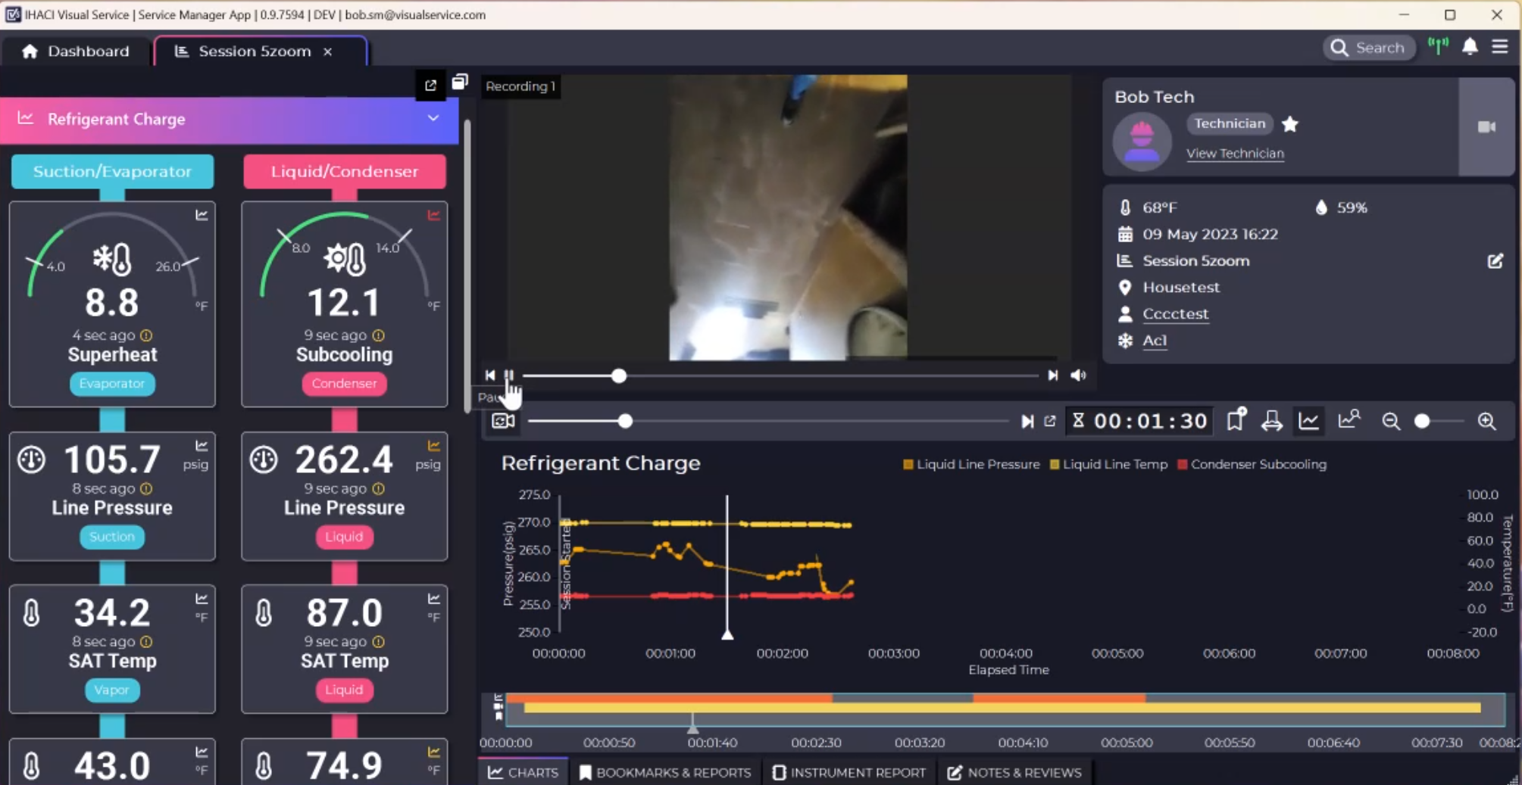

Slide 7
Visual Service Software
Bob Wiseman, IHACI
Research Question:
How can virtual monitoring of installations and service calls support quality installations and expand the HVAC workforce?
Notes:
Also discuss basic details of project – what is Visual Service and how do you use it?

Slide 8
Pilot Activities
7 contractors and 37 technicians enrolled
300 triage evaluations and 20 installations completed using Visual Service
Jan | Feb | Mar | Apr | May | Jun | Jul | Aug | Sep | Oct | Nov | Dec
Visual Service trainings
Visual Service used on triage evaluations and installations
Evaluation
Training on the use of Visual Service
Wireless enabled tools provided to participating contractors
Visual Service utilized on HVAC servicing and installations
Evaluation and verification of project results and contractor satisfaction
Scaling the use of wireless monitoring tools into workforce development efforts

Slide 9
Key Results
KPI/Goal | Metric | Data Source | Project Results
Triage evaluations | Number of service calls | Existing systems evaluations | 300
Certification evaluations | Total installations evaluated | New installation evaluations | 6
Customer satisfaction | Customer satisfaction of system performance | Customer satisfaction survey | N/A
New system installations resulting from triage evaluations | Total number of systems installed | Contractor reporting | 14
Contractor evaluation of Visual Service | Contractor rating of Visual Service | Contractor evaluation survey | 9.2/10
Visual Service gives our customers insight into how their system is really performing. I love it!”
Eddie Perez, CPHAC
For a full project report, visit the TECH Clean California website at https://techcleanca.com/quick-start-grants/

Slide 10
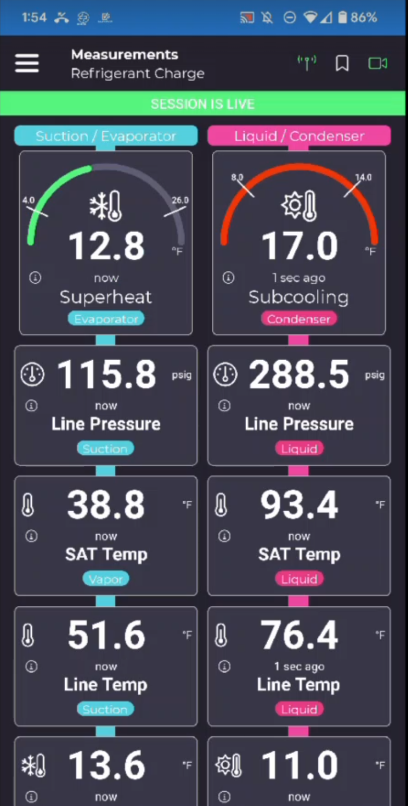
Key Learnings
Service technicians responded well to the trainings and had the technical competency to utilize Visual Service but did not establish it as part of their routine process.
Trainings should be provided in-house with individual contractor firms, with a focus on support and mentorship.
Service technicians often did not recommend repairs for systems that are not operating at maximum efficiency, despite these repairs being flagged by Visual Service.
Refrigerant reclamation and monitoring have become prominent areas of focus for the HVAC industry, and tools to track refrigerants in the field are needed.

Slide 11
Next Steps
More research needs to be done to ascertain the monetary value the software provides and communicate that to contractors.
Collaboration with the California Energy Commission to recognize Visual Service as a pathway for Title 24 compliance would expand the usefulness of the software.
Visual Service and associated trainings should be made more accessible to technicians and installers by being available in Spanish and by being offered as in-house trainings.
Installer trainings focused specifically on system start-up, that provide the knowledge necessary to perform quality work while remaining accessible to installers of all backgrounds, should be offered.
Notes:
What are your immediate next steps to scale your approach? What are your immediate next steps to disseminate lessons learned? Who will be your main audience?
Are there specific lessons learned through the pilot that will inform your own operations or help grow your organization?

Slide 12
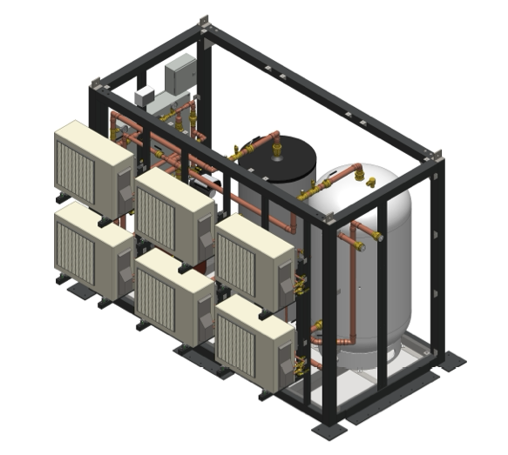
Central Heat Pump Boiler Innovation with WaterDrop Systems
Albert Rooks, Small Planet Supply
Research Question:
Can a pre-packaged central water heating system simplify installations and lower costs for multifamily properties?
Notes:
- Natural refrigerant – What is the project all about

Slide 13
Pilot Activities
5 systems manufactured
5 systems installed
Jan | Feb | Mar | Apr | May | Jun | Jul | Aug | Sep | Oct | Nov | Dec | Jan | Feb
Engineering & manufacturing design
Manufacture products
System installations and start-ups
Ongoing M&V
Develop concept of “plug and play” central HPWH
Complete design and incorporate modular components
Install systems in low-income farmworker housing
Perform ongoing M&V to validate approach and assess bill savings
Collaborate with local distributors and assess market demand
Scale production of pre-packaged central HPWH systems

Slide 14
Key Results
KPI/Goal | Metric | Data Source | Project Results
Install pre-packaged central HPWH | Number of installations | Iris | 5
Reduce costs of WaterDrop Systems | Cost per unit | Pre-engineered and pre-fabricated Droplet compared to custom engineered and site construction | 32% cost savings
Reduce GHG emissions | Percentage of refrigerant leaks | Based on industry norm for standard HFC refrigerants used in a typical heat pump | 100%
The cost savings were significant. We found that we were able to reduce cost to the customer by 32% when compared to the typical custom designed plant.”
Albert Rooks, Small Planet Supply
For a full project report, visit the TECH Clean California website at https://techcleanca.com/quick-start-grants/

Slide 15
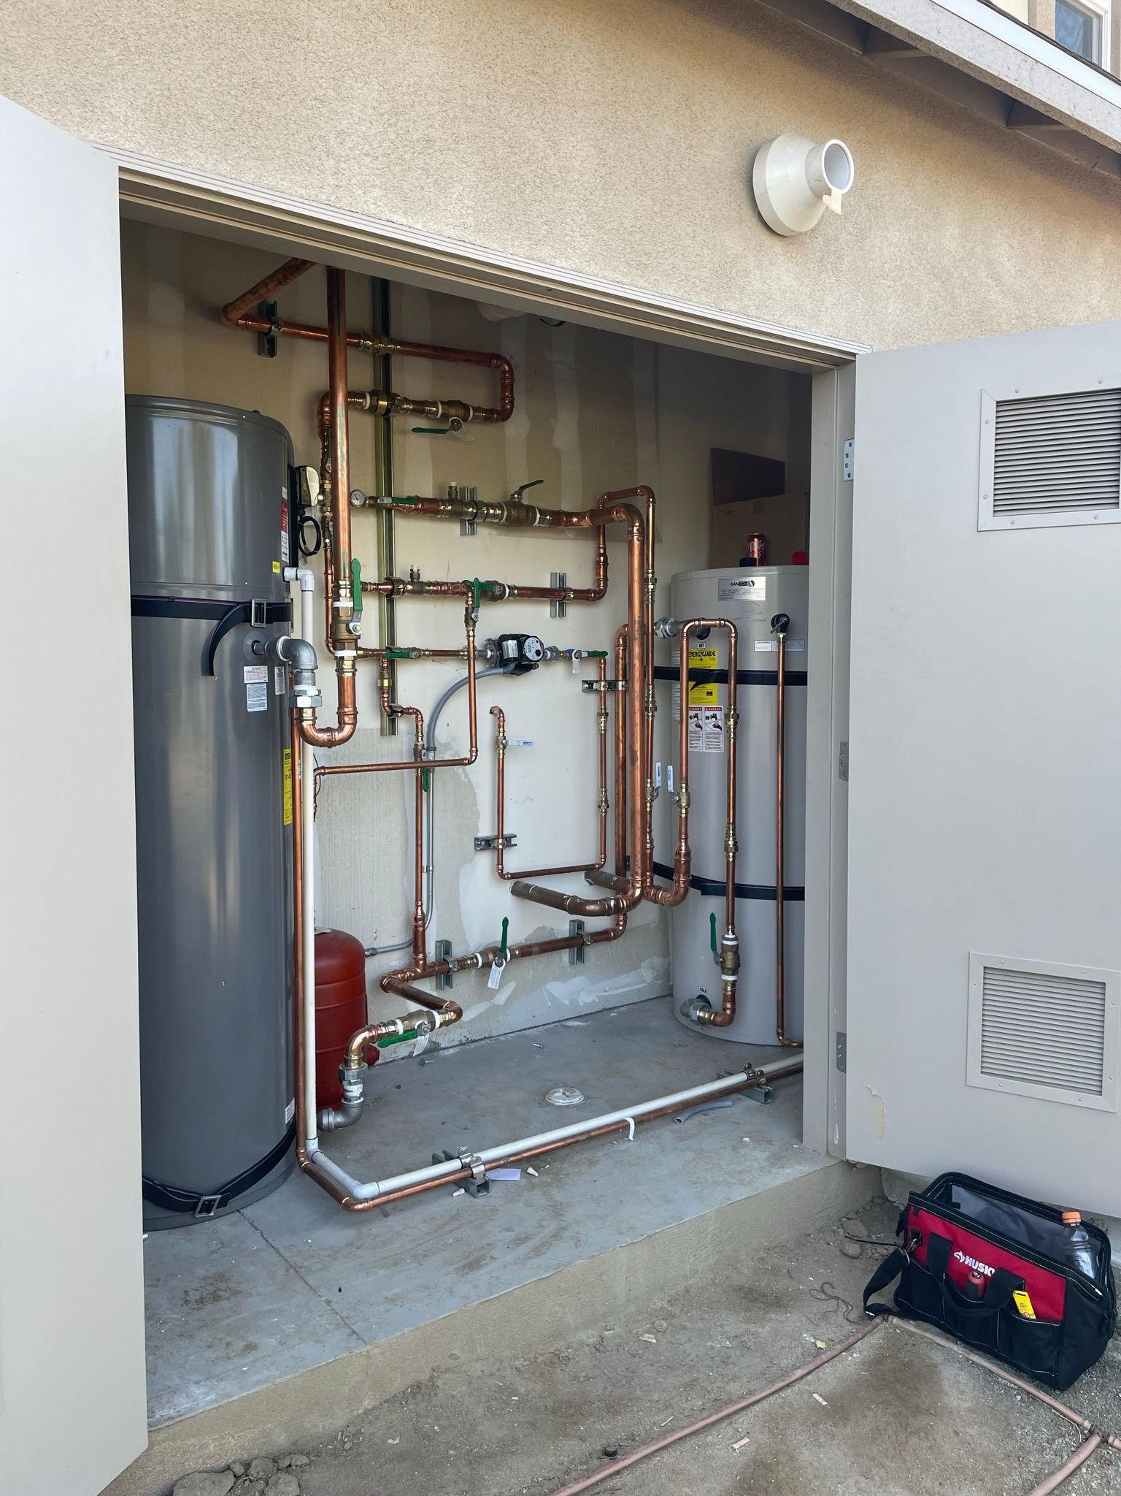
Key Learnings
Size constraints of mechanical rooms in small multifamily buildings necessitate a flexible product design with modular components.
Existing calculator tools used to size central water heater systems (i.e. Ecosizer) must be refined to work correctly for small multifamily buildings
Industry education is necessary to ensure accurate inspection procedure for central heat pump water heaters.

Slide 16
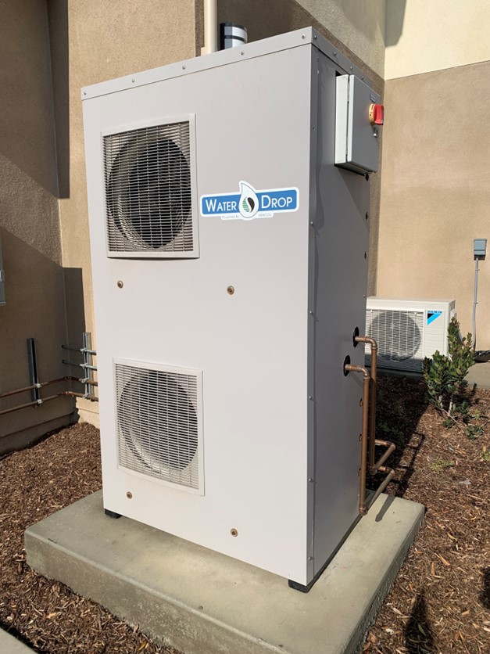
Next Steps
Develop upgraded controller to simplify the start-up process
Build sales channel by working with utility partners to identify available incentives
Educate installation contractors on small multifamily buildings

Slide 17
Q&A and Panel Discussion
3

Slide 18
Closing
4

Slide 19
Connect with Us
Respond to survey linked in the chat
Attend our upcoming Quick Start Grant webinars
Enabling Faster Installations, Part 2: Barnett Plumbing and NBI
Wednesday, July 26 at 12:00 Noon PT
Register here: https://tinyurl.com/33vy8uhc

Slide 20
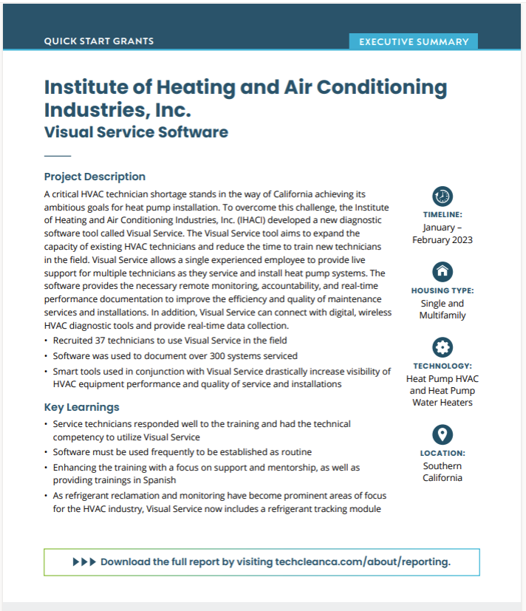
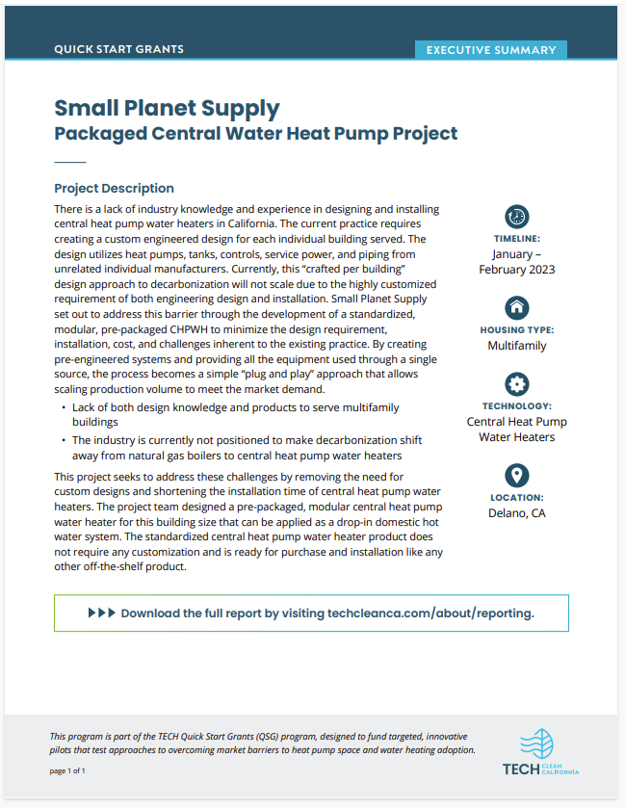
Learn More

Slide 21
Thank You
For more information, contact:
Kalee Whitehouse, VEIC
kwhitehouse@veic.org
Tre’Laine
https://techcleanca.com/

