Slide 1
Quick Start Grant Webinar Series: Enabling Faster Installations Part II
Presented by Barnett Plumbing and New Buildings Institute
July 26, 2023

Slide 2
TECH Clean California & the Quick Start Grant Program
California’s goal: 6 million heat pumps installed by 2030
Climate change-ready / friendly homes (3 million by 2030)
50% of funding delivered to low-income households or disadvantaged communities
TECH Clean California Strategy
Encourage deployment innovation
Rapidly refine specific needs
Test innovative program delivery models that address key market barriers and increase access to electrification
Provide the funding source innovative approaches need to scale
QUICK START GRANT PROGRAM

Slide 3
Agenda
1 | Replacement Water Heater Emergency Loaner Program Benjamin Foster, Barnett Plumbing
2 | Statewide 120-Volt HPWH Field Study Amruta Khanolkar, New Buildings Institute
3 | Q&A and Panel Discussion Amruta Khanolkar, New Buildings Institute Benjamin Foster, Barnett Plumbing Chris Badger, VEIC Evan Kamei, Energy Solutions Jed Hannemann, Energy Solutions

Slide 4
Participation Logistics
You are automatically muted by Zoom upon entering the webinar
Please submit questions through the Q&A function (please indicate who your question should be directed to)
Fill out the post-webinar survey with your contact information if you’d like to get involved!

Slide 5
Grantee Presentations
2

Slide 6
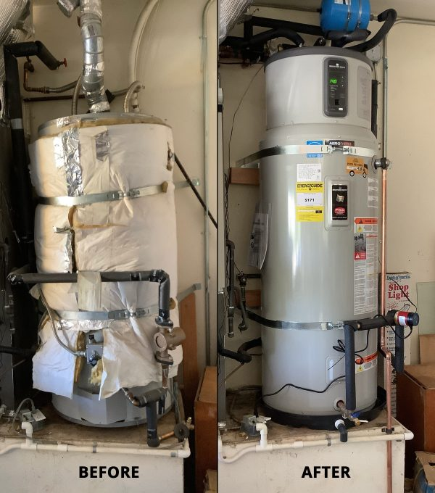
Replacement Water Heater Emergency Loaner Program
Benjamin Foster, Barnett Plumbing
Research Question:
Will offering customers a loaner gas water heater in emergency replacement scenarios increase the likelihood that they will switch to heat pumps?
Notes:
Describe project and what the objective was

Slide 7
Pilot Activities
43% customer conversion rate in Q3
Exceeded installation goal
Jan | Feb | Mar | Apr | May | Jun | Jul | Aug | Sep | Oct | Nov | Dec
Marketing plan & employee training
System installations and start-ups
Develop marketing plan and train employees as HPWH specialists
Educate customers on the program and benefits of fuel-switching
Perform loaner installations alongside HPWH retrofits
Establish funding source for loaner program
Create in-house training opportunities for contractors

Slide 8
Key Results
KPI/Goal | Metric | Data Source | Project Results
Install 144 HPWH | Number of HPWH installations | Customer relationship manager software | 149
Increase gas boiler to HPWH conversion rate to 18% | Percentage of customers converting from gas systems | Historic sales and project installation data | 17.1%
Educate customers on HPWH benefits, programs, and incentives | Percentage of customers receiving information | Customer relationship management software | 95%
Our water heater broke and we contacted Barnett (Sunday evening). … A temporary was installed on Monday. They coordinated an electrician to come out to run the electrical and then install the new hybrid water heater. It was a big job but seamless to us.”
Sue T. (Yelp)

Slide 9
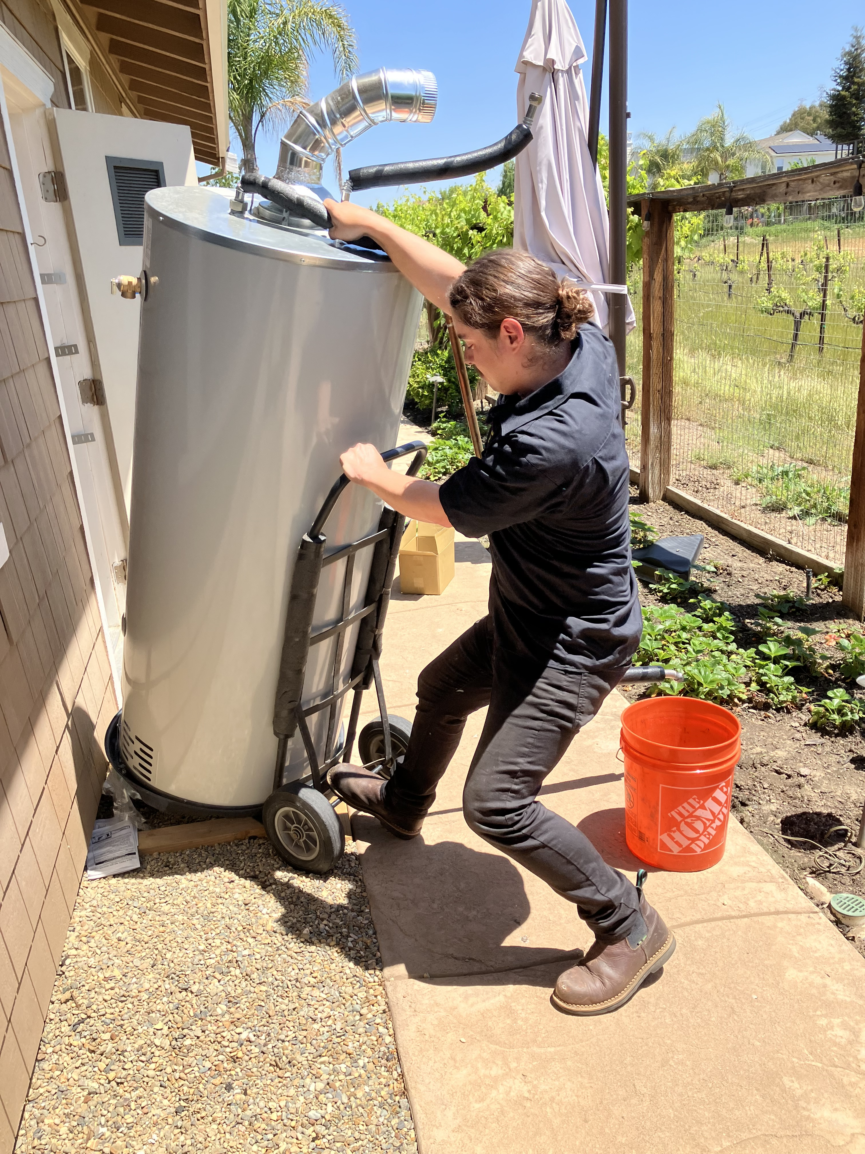
Key Learnings
Cost, convenience, and trust are three main pillars of creating an effective value proposition for fuel-switching.
Reliable and stable funding to reduce costs of HPWH is crucial for installations to scale.
The effectiveness of the loaner model still depends on the ability to address retrofit barriers.
Expanding the loaner model would require a coordinated effort among many partners

Slide 10
Next Steps
Technician training focused specifically on HPWH service and installations, offered in-house by contractors, can support the development of skilled technicians from all backgrounds.
CCAs, regional energy networks, and municipal utilities are important partners to explore how the loaner model may fit with their portfolio of decarbonization strategies.
Incentives and funding opportunities must be streamlined.
The gas loaner model could be incorporated into existing low-income appliance replacement programs offered by utilities.
Notes:
What are your immediate next steps to scale your approach? What are your immediate next steps to disseminate lessons learned? Who will be your main audience?
Are there specific lessons learned through the pilot that will inform your own operations or help grow your organization?

Slide 11
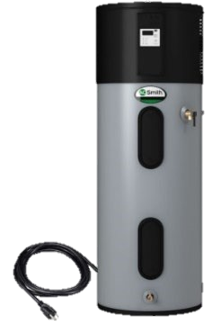
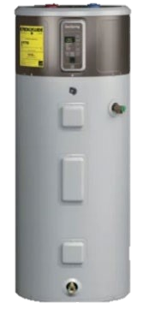
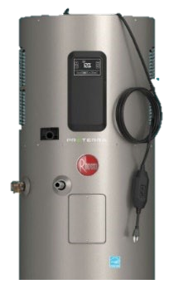
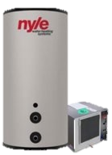
Statewide 120-Volt HPWH Field Study
Amruta Khanolkar, Mischa Egolf and Noah Gabriel, New Buildings Institute
Research objective:
Validate the hot water delivery/energy performance, customer satisfaction and installer acceptance of emerging 120-V heat pump water heaters.

Slide 12
Pilot Activities
16 systems installed
32 systems installed
Jan | Feb | Mar | Apr | May | Jun | Jul | Aug | Sep | Oct | Nov | Dec | Jan | Feb | … | June
Outreach & site selection
120V HPWH installations across California climate zones
Data collection and analysis
Conduct outreach to contractors, identify participating sites
Target building types, install locations, demand profiles, climate zones etc.
Perform installations of 120V HPWH in CA gas IOU service territories
Collect and analyze performance data and customer satisfaction.
Establish funding source for market connection/collateral building
Support market introduction of 120V equipment

Slide 13
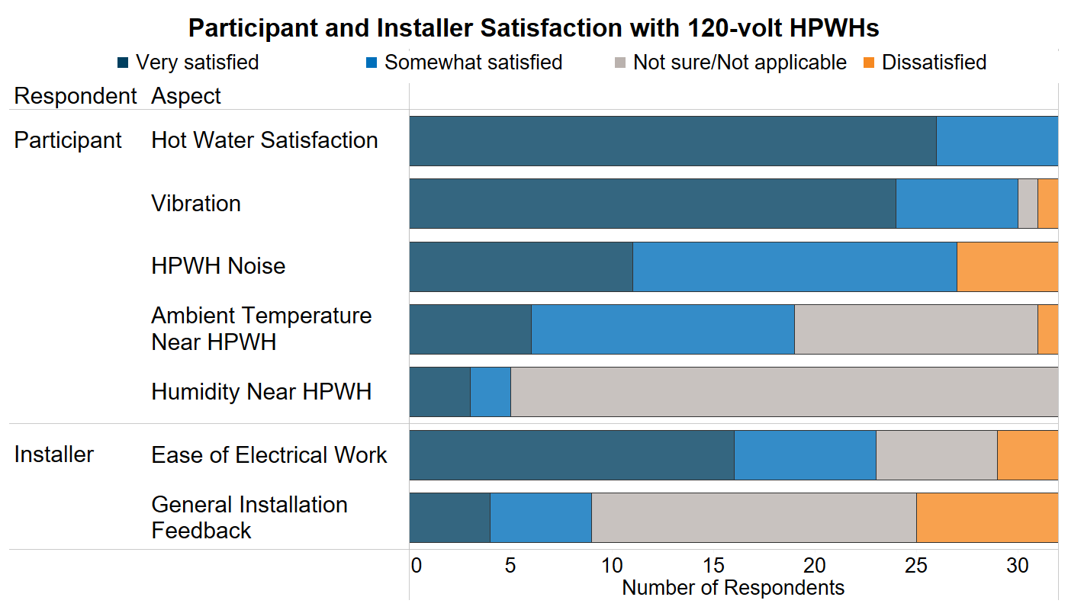
Key Results
Plug-in, 120-volt HPWHs are a solution
for retrofit market decarbonization.
For low-medium (1-4 people) hot water demand sites.
For more information, see link here

Slide 14
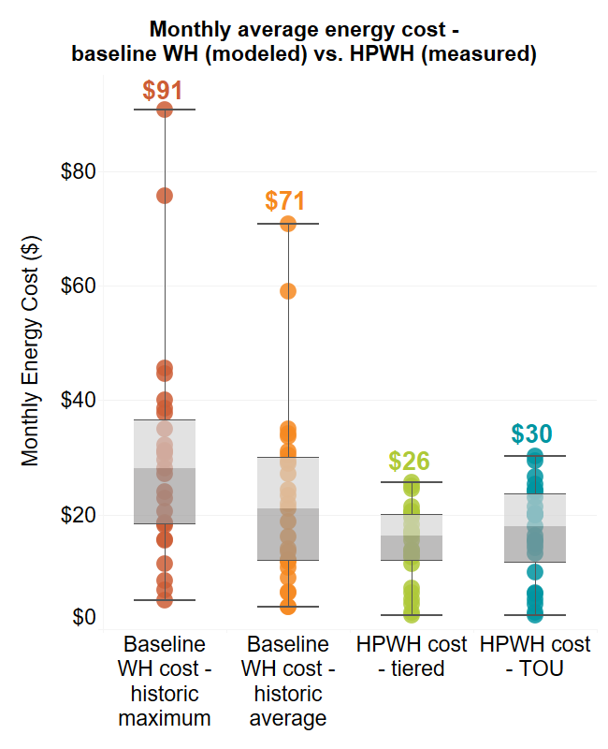
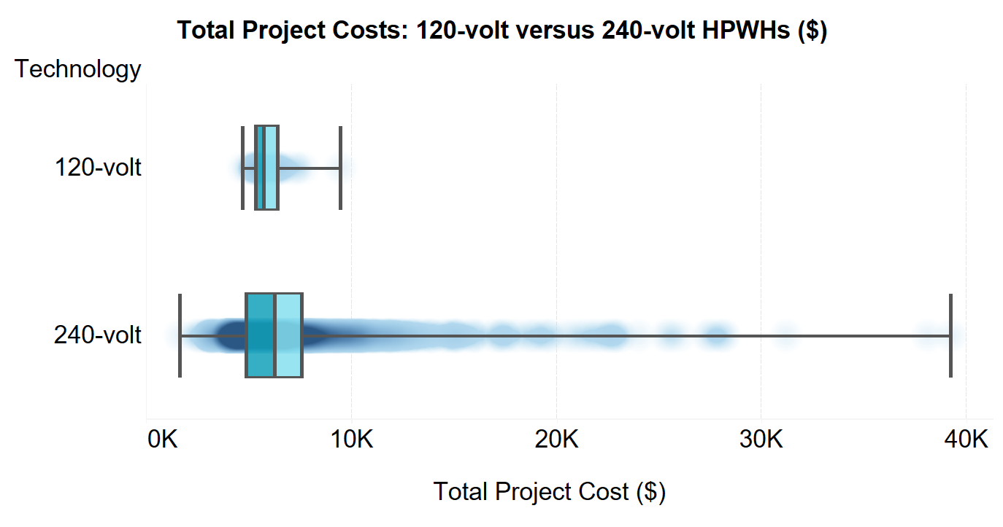
Key Results
More narrow and predictable project costs, solution for emergency replacements!
“Overall, the unit is working very well and our experience is very similar to the gas unit it replaced. I believe our gas bill is much lower than the increase in the electric bill. I anticipate adding a schedule to the unit, so it does not operate during the peak rate time, but with SMUD winter rates the difference is negligible.”
For more information, see link here

Slide 15
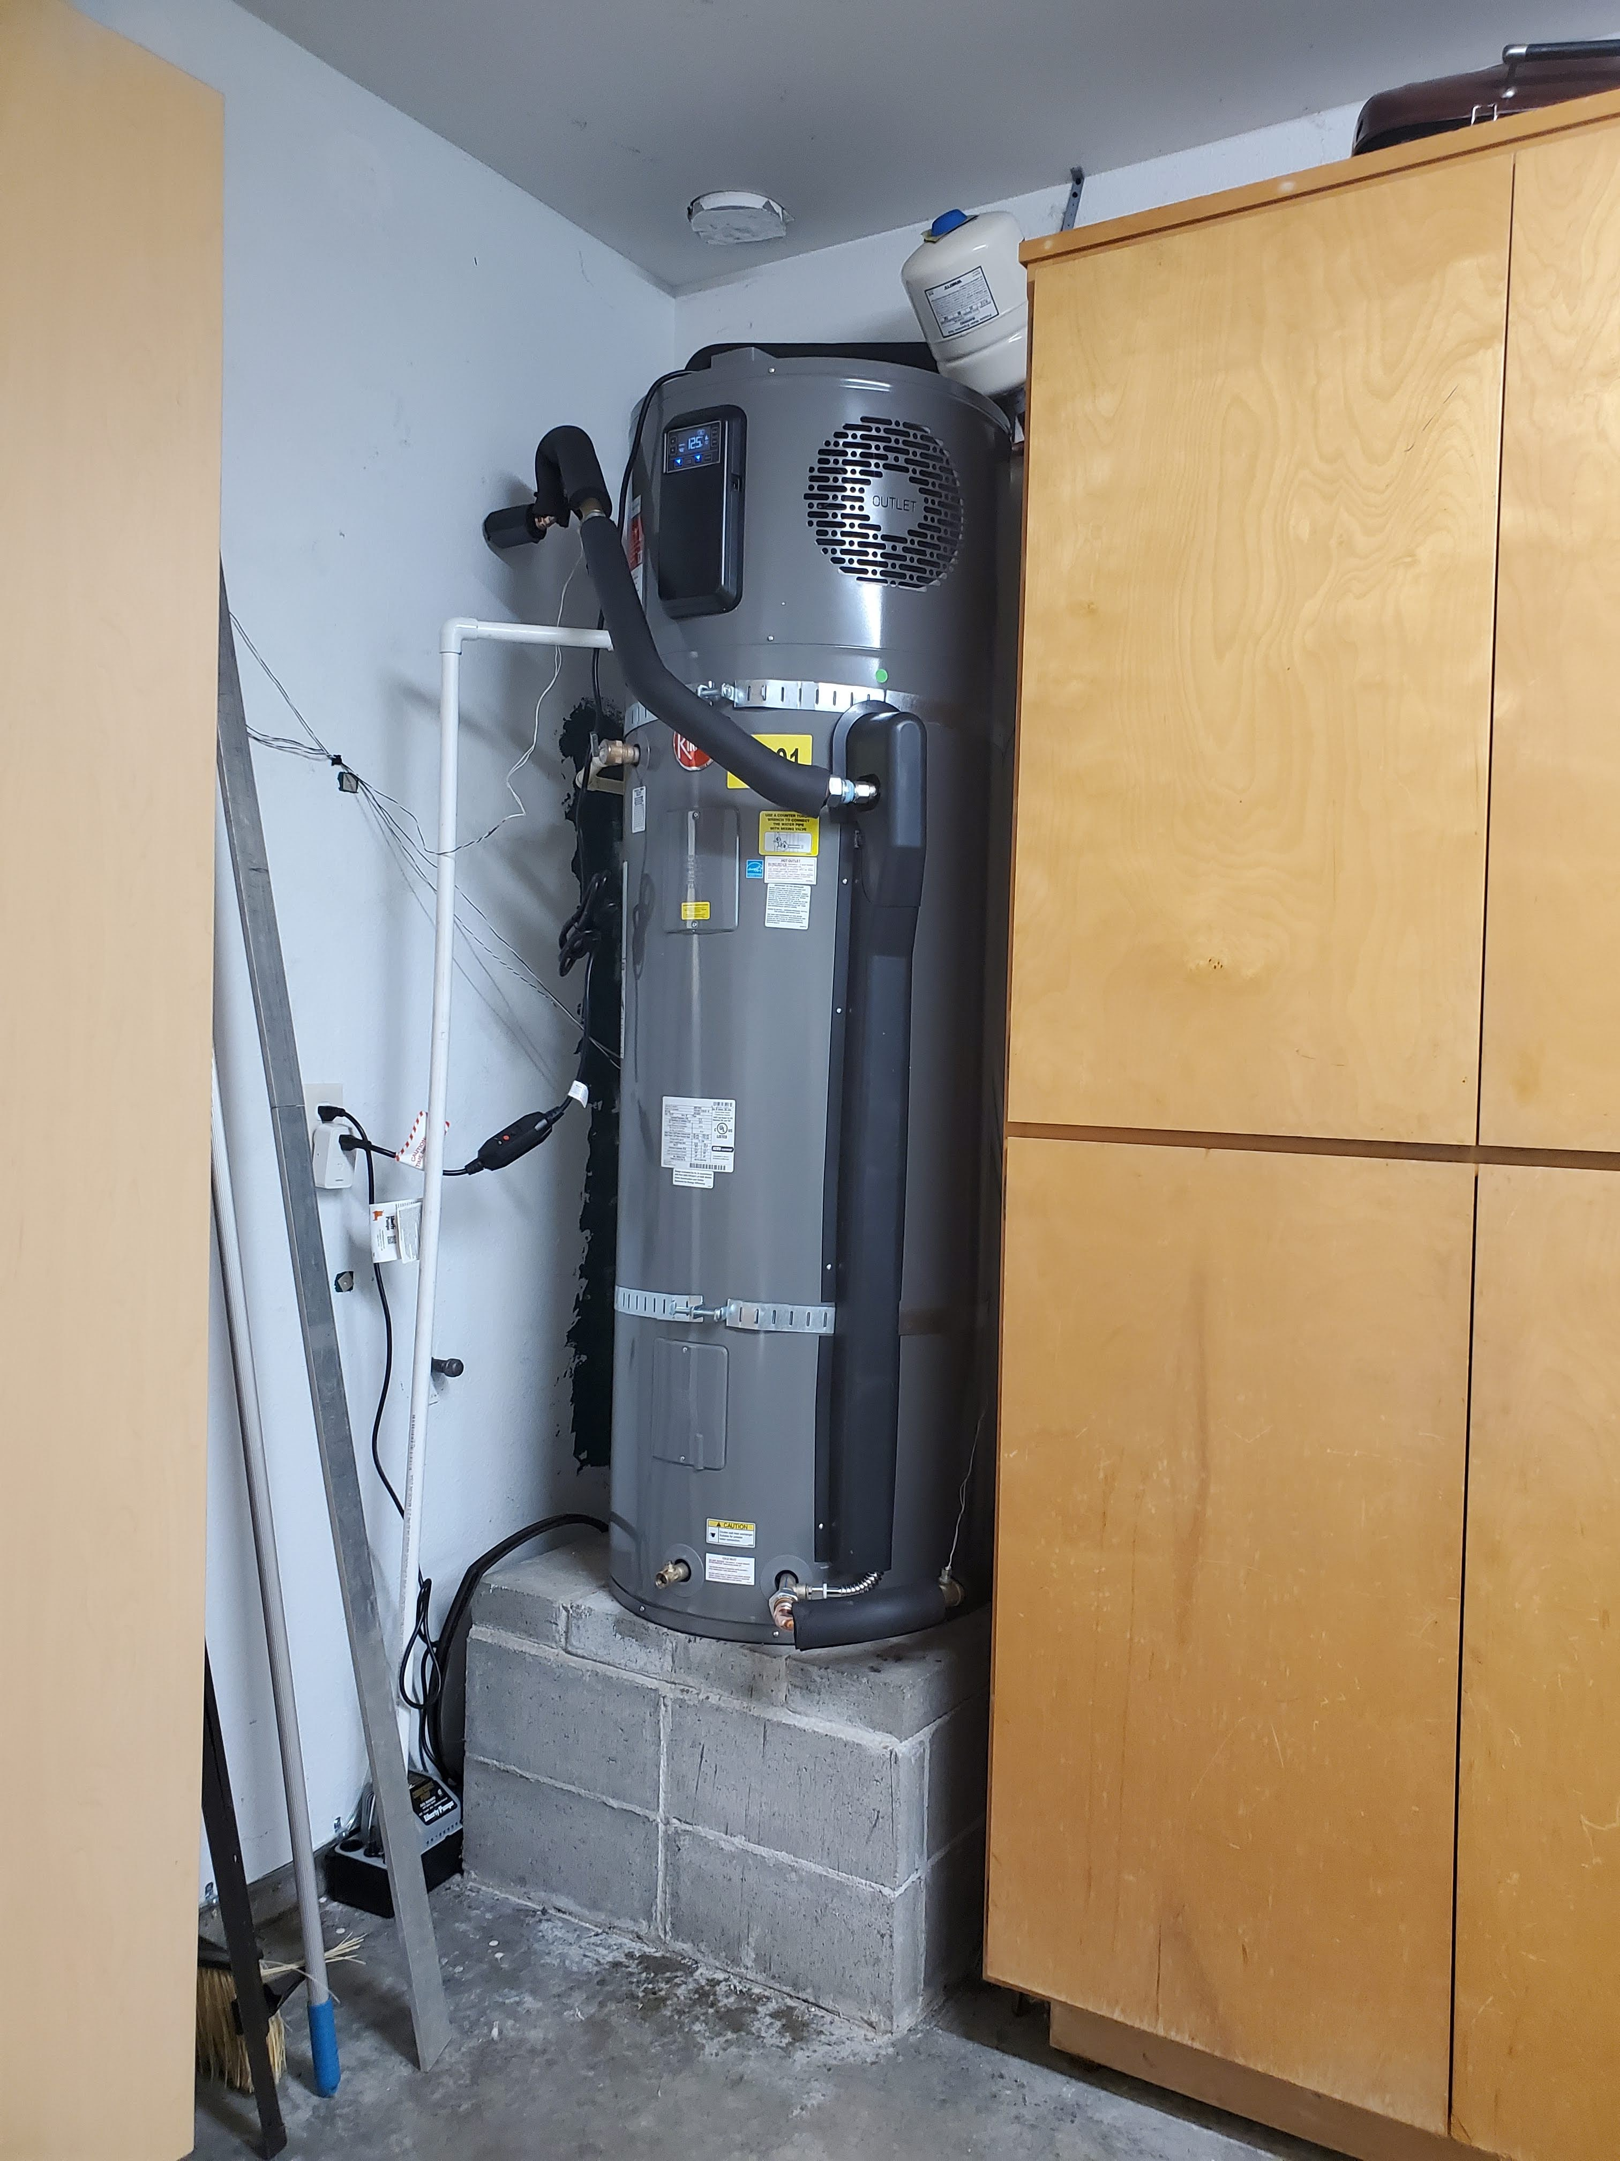
Key Learnings
These are very low amperage draw heaters, while rated at 15 amps they were only pulling 4-6 amps of current during the monitoring period.
We observed an average monthly energy consumption savings of approximately ~80% in comparison to the pre-existing gas/propane water heaters. In addition, about 60% of the sites showed operating costs savings as compared to the pre-existing gas or propane water heater.
The 120-volt HPWHs are designed to reduce cost and complexity that customers may incur from installing a standard 240-volt HPWH in a fuel switching retrofit. Based on the study findings, they saved between $800 and $15,000 per household compared to 240-volt HPWH installation, primarily due to the minimal electrical interventions.
Notes:
- Which market sector is this best for?

Slide 16
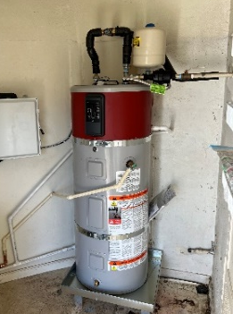
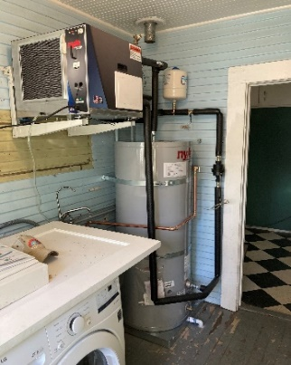
Next Steps
Creating demand with equity focus: 120-volt HPWH products should be absorbed into existing HPWH incentive programs as soon as possible. Maximize outreach within low-income communities to ensure they benefit from the reduced energy burden provided by the 120-volt HPWH.
Education and workforce development: because this technology is emerging, training installers is paramount to ensure best possible performance and lack of installation issues.
Permitting officer training: it’s critical to ensure that permitting officers are aware and accepting of 120-volt HPWHs to prevent delays.
Update California plumbing code: modifying the plumbing code to have separate requirements for new technologies would allow for more accurate WH sizing.

Slide 17
Q&A and Panel Discussion
3

Slide 18
Closing
4

Slide 19
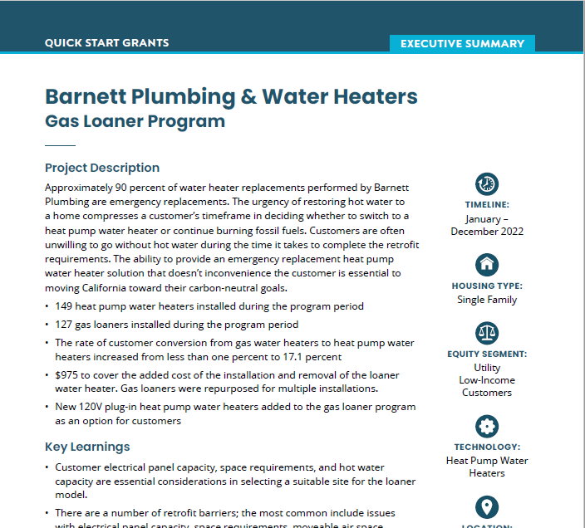
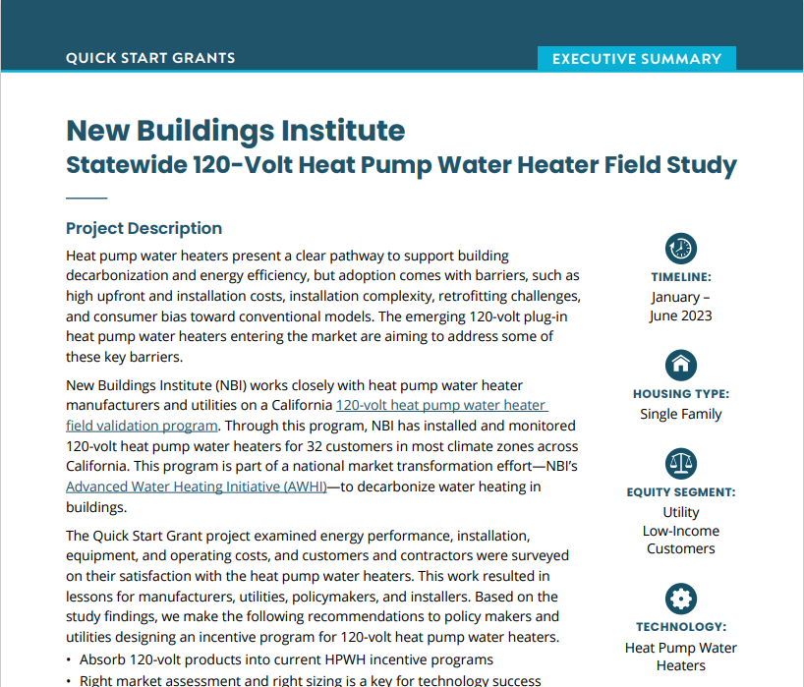
Connect with Us
Respond to survey linked in the chat and provide your contact info
Look for upcoming QSG webinars in September with Revalue, Redwood Coast Energy Authority, and Franklin Energy
Learn more: Final reports on these and other grantees are available soon at https://techcleanca.com/quick-start-grants/

Slide 20
Thank You
For more information, contact:
Alison Seel, VEIC
aseel@veic.org
Tre’Laine
https://techcleanca.com/

